Slide 1
Request for proposals (RFP)
Presenters: Michele Eaton, Executive Director
Christina Sauceda, Chief Program Officer
Direct Services RFP 2024-2027

Slide 2
Request For Proposals (RFP)
Purpose of RFP
Overview of Project Scope
Eligibility
Requirements
Desirable Qualities
Important Deadlines

Slide 3
Purpose of the RFP
First 5 Tulare County seeks proposals from qualified organizations to provide services to children from the prenatal stage through five years of age and their families living in Tulare County. These services must achieve measurable results consistent with the First 5 Tulare County Strategic Plan 2023 through June 2028.
Proposition 10 funds may not supplant existing state or county general fund resources or create duplicate services.

Slide 4
Overview of Project Scope
Approximately $3 million is available for each year of a three-year funding cycle commencing July 1, 2024, and ending June 30, 2027. First 5 Tulare County will designate $1.5 million of the total each year to fund Family Resource Centers (FRCs). Due to declining revenue forecasts, First 5 will fund a maximum of $250,000 per year to eligible programs.
Organizations may submit more than one proposal for distinct sets of proposed interventions. Specific amounts for proposals will depend on the nature and scale of the proposed interventions and the degree in which a proposal contributes to First 5 Tulare County’s goals relative to total available funds.

Slide 5
Eligibility
Through this competitive process, the Commission will make grant awards to applicants demonstrating the greatest expertise and qualifications to successfully develop, implement, and manage their programs. Public and private organizations that have the organizational capacity to achieve the purposes of their programs and provide appropriate fiscal oversight and accountability are eligible to apply. Grants will not be made to individuals or sole proprietors under this program.

Slide 6
Eligibility
Existing organizations including public agencies, nonprofit organizations, and for-profit corporations;
Demonstrated experience and expertise related to the activities outlined in the program application;
Sufficient financial resources and fiscal management practices to successfully carry out the program;
No record of unsatisfactory performance or poor business practices;
For currently funded organizations; past performance will be considered when making funding recommendations.
Capacity to conform to all requirements set forth in this RFP and any subsequent project agreement.

Slide 7
Requirements
Record-Keeping and Reports: Successful applicants, including any subcontractors, must institute sound programmatic and fiscal record-keeping practices. Fiscal reports will be submitted four times per program year, typically one month after the end of each fiscal quarter.
Program Revenue: If activities funded by First 5 generate revenue from other sources, that revenue must be budgeted and reported to First 5.
First 5 Policies: Successful applicants will conform to First 5 Tulare County policies including confidentiality, attribution requirements, supplantation, service age, equity and diversity, and others.

Slide 8
Requirements
Insurance Requirements: Successful applicants must maintain and submit annual proof of insurance with an endorsement naming First 5 Tulare County as an additional insured.
Data Collection and Evaluation: Successful applicants will collect client-level data on children and their families’ receiving services through their programs. Required data may include the following: unduplicated client count, family demographic information, child outcomes, performance measures, monthly and quarterly data submissions, pre/post assessments and others.
Audit: Any organization receiving $250,000 or more per year from First 5 Tulare County must have an annual financial audit. If an organization does not currently conduct an annual audit, the cost of the audit may be included as an expense in the program application.

Slide 9
Requirements
Term of Projects: All activities to be funded by First 5 Tulare County under this RFP will commence on or after July 1, 2024, and conclude no later than June 30, 2027. While agreements will be for three years, budget reconciliations will be completed after the first and second years. Unexpended funds will be deducted from the total grant award.

Slide 10
Desirable Qualities
Children’s Health
Mental Health
School Readiness
Family Resource Centers
Parent Education
Community Education
Capacity Building
Advocacy

Slide 11
Required Attachments
Cover Page
Applicant Disclosure Statement
Strategic Plan Consistency Statement
Proposal Narrative
Budget (one for each year and three-year total)
Budget Narrative (three years combined)
Scope of Work (Attachment A)
Evaluation Plan (Attachment C)

Slide 12
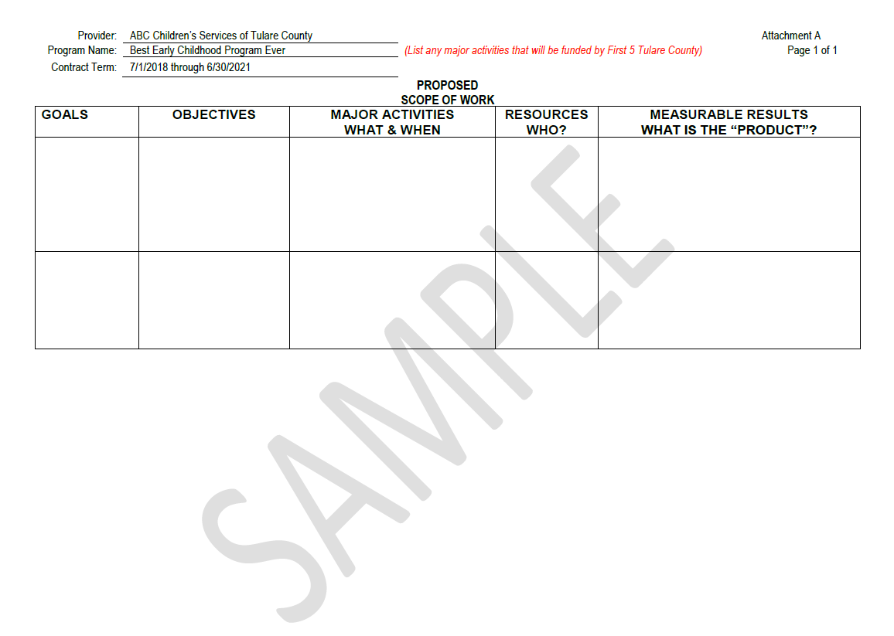
First 5 Strategic Plan 2023-2028

Slide 13
1
2
3
4
5

Slide 14
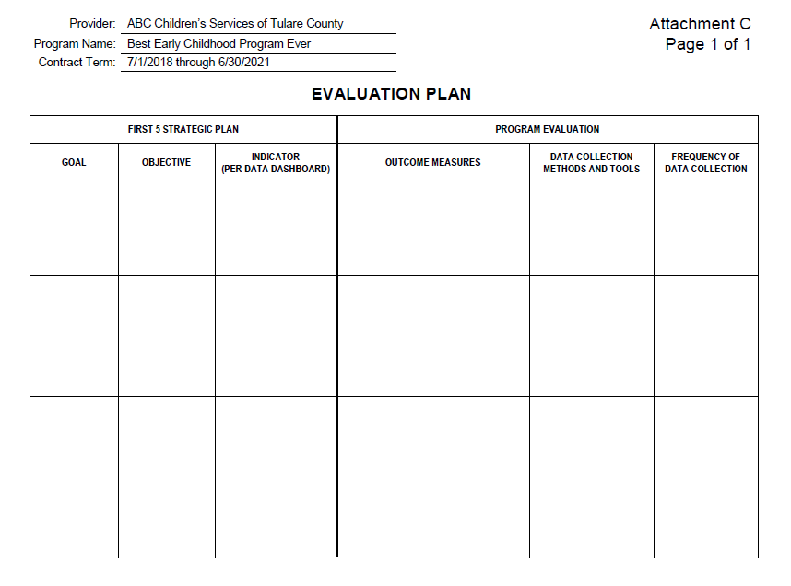

Slide 15
1
2
3
4
5

Slide 16
Important Deadlines
February 22, 2024 final day to submit questions via email to info@first5tc.org. (questions will not be answered via telephone). Title subject: RFP 2024-27 Questions
February 29, 2024 Proposals due to First 5 Tulare County Office no later than 12:00 p.m.
April 25, 2024 First 5 Tulare County selects proposal for funding.
May through June 2024 Contract negotiations.
July 1, 2024, Grant programs commence.

